Slide 1
Portability
Rohan Yadav and Charles Yuan
(rohany) (chenhuiy)

Slide 2

Portability in Multiple Contexts
Improving legacy code
Architecture Adaptive Variant Selection
Architecture Specific Optimization

Slide 3
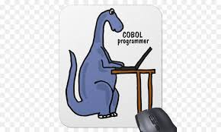
Improving Legacy Code
COBOL
Big idea is to reconstruct “High Level Information” from old binaries
Use HLI to perform new optimizations without source
Many of these are only possible due to COBOL…
Stack and Heap variables are offset relative to static locations
Cobol runtime functions are all located in particular memory locations
Constant Pool is similar

Slide 4
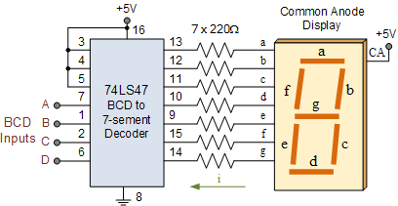
Making BCD’s not suck
These operations are incredibly slow
Author’s identify and remove as many BCD op’s as possible
Store intermediate results in registers
Replace runtime BCD functions with better implementations

Slide 5
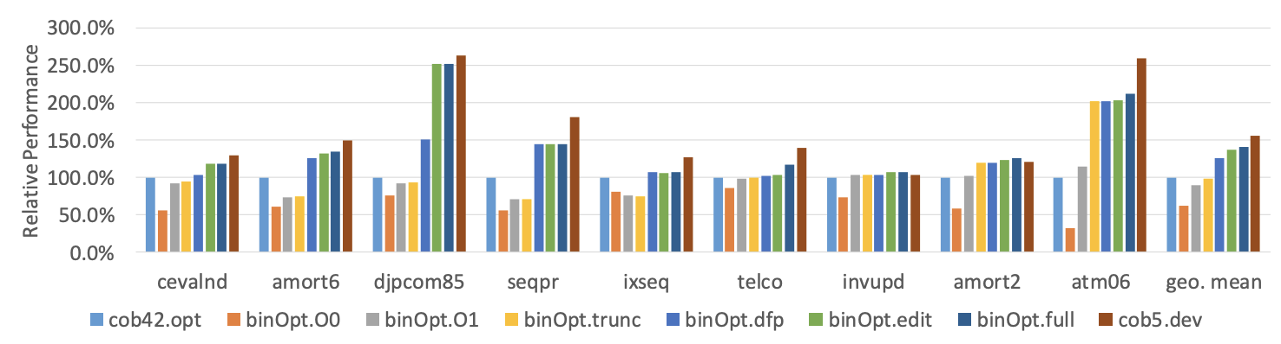
Results

Slide 6
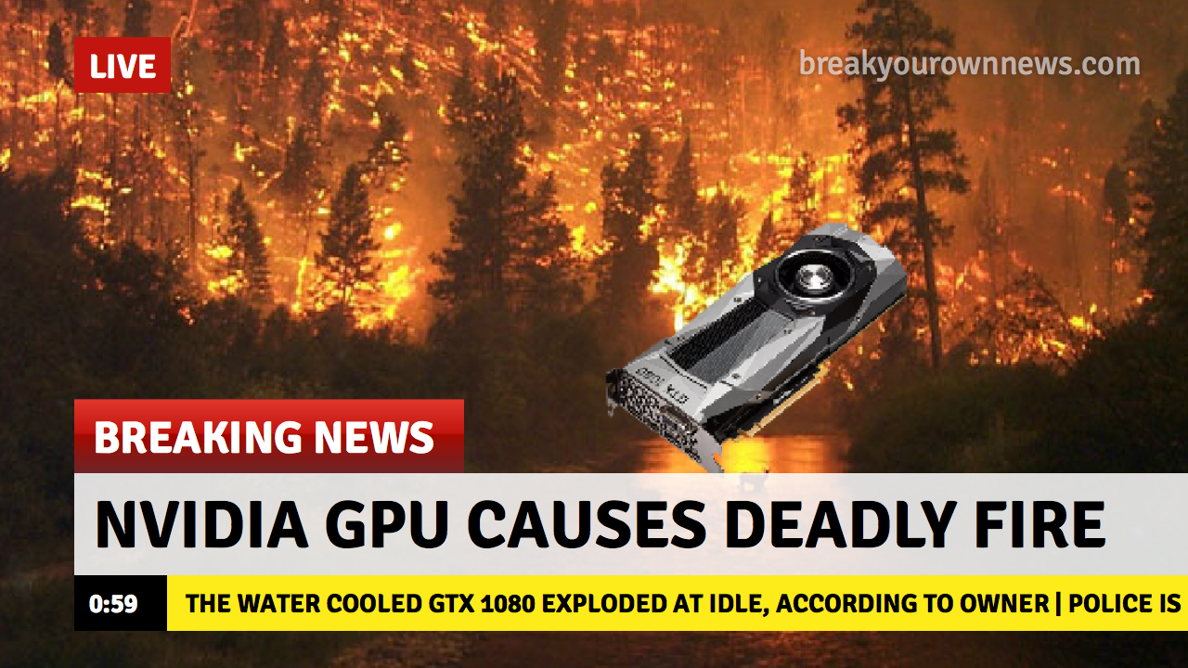
Architecture Adaptive Code
Different GPU architectures support operations better than others
Select algorithm implementation based on these differences using Machine Learning
Don’t want to train on a new architecture every time!

Slide 7
Approach
Collect device features (core count, clock rates, atomic performance … )
Find the features most relevant to variant’s performance
Can try using all the features (doesn’t perform well)
Profile kernels to find which device features are most important for that kernel
Further limit search space by performing cross validation on target architecture

Slide 8
Approach Cont.
Train on a set of source architectures
Use data collected to create a model on the target architecture

Slide 9

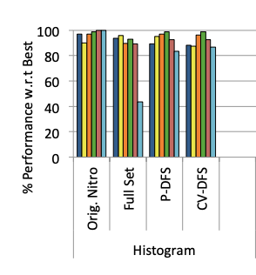
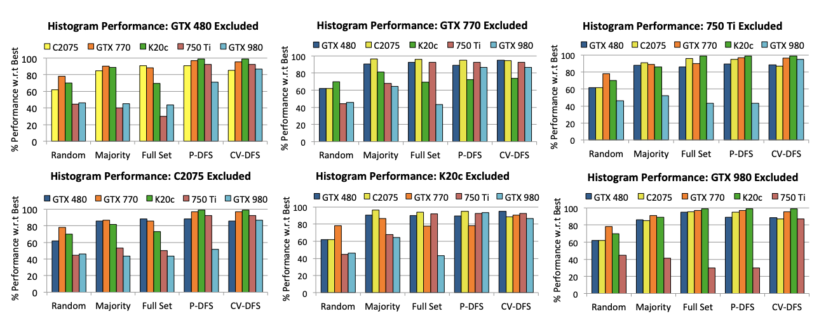
Results

Slide 10

Architecture Specific Code
Compilers rely on architecture-specific information
Cost models, memory models, optimization decisions
Models are very complicated

Slide 11

Obtaining models
Large number of programs run many times and analyzed
Samples are redundant and excessive
Experts can write heuristics to shortcut the process

Slide 12
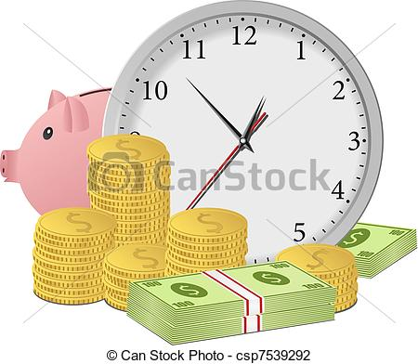
Obtaining models
Problem 1: writing heuristics takes years (and millions)!
Problem 2: hardware is changing (more heterogeneous) all the time!

Slide 13
Big Idea #1
Machine Learning

Slide 14
How to use ML?
Iterative compilation - automatically deriving heuristics by training predictors to select optimizations
Can outperform expert-written heuristics!
Still a problem: random search wastes a ton of time

Slide 15
Big Idea #2
Active Learning

Slide 16
What does that mean?
Don't just randomly run programs and then train
Identify where most optimization is possible and move in that direction!
Key objective: minimize #samples per example

Slide 17
Sequential Analysis
Candidate set: possible next example to use for training
Traditionally: keep training set disjoint from candidate set
New algorithm: in main loop, consider not only a new example but whether an old one is useful again

Slide 18
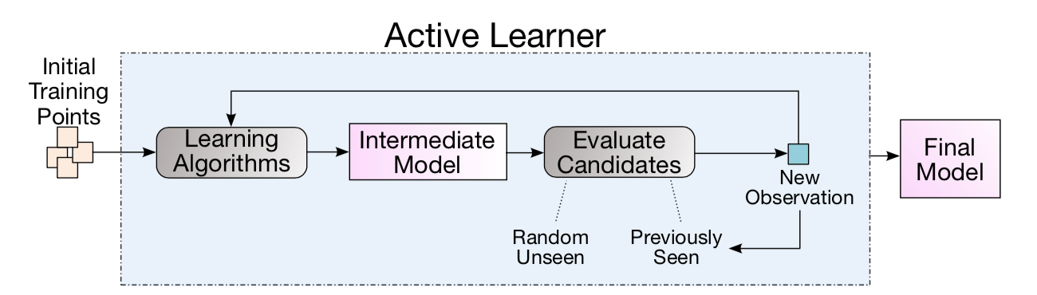
good quality data to start
one observation at a time
previous data stays in candidate set
repeat until complete

Slide 19

Algorithmic Tools
Problem: need to estimate uncertainty of prediction
Solution 1: Gaussian Process (GP)
But GP is cubic time.
Solution 2: Dynamic Trees

Slide 20
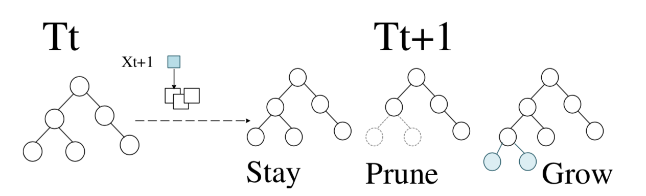
partition state space into hyperrectangles
of similar outputs
maintain decision tree of hyperrectangle nodes
stochastically choose one of three manipulations
result: no pruning at end, resistance to noisy data!

Slide 21
Evaluation
Task: find optimal set of compilation parameters for program
Loop unrolling, cache tiling, register tiling
SPAPT suite of search problems for automatic performance tuning
Stencil codes, linear algebra, other HPC problems
Compare against baseline ML approach

Slide 22
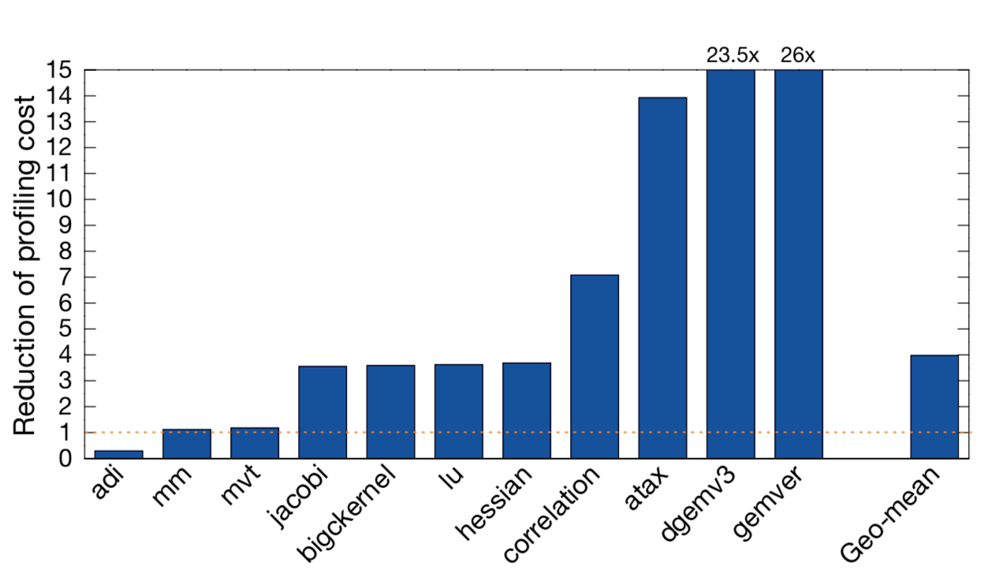

Slide 23
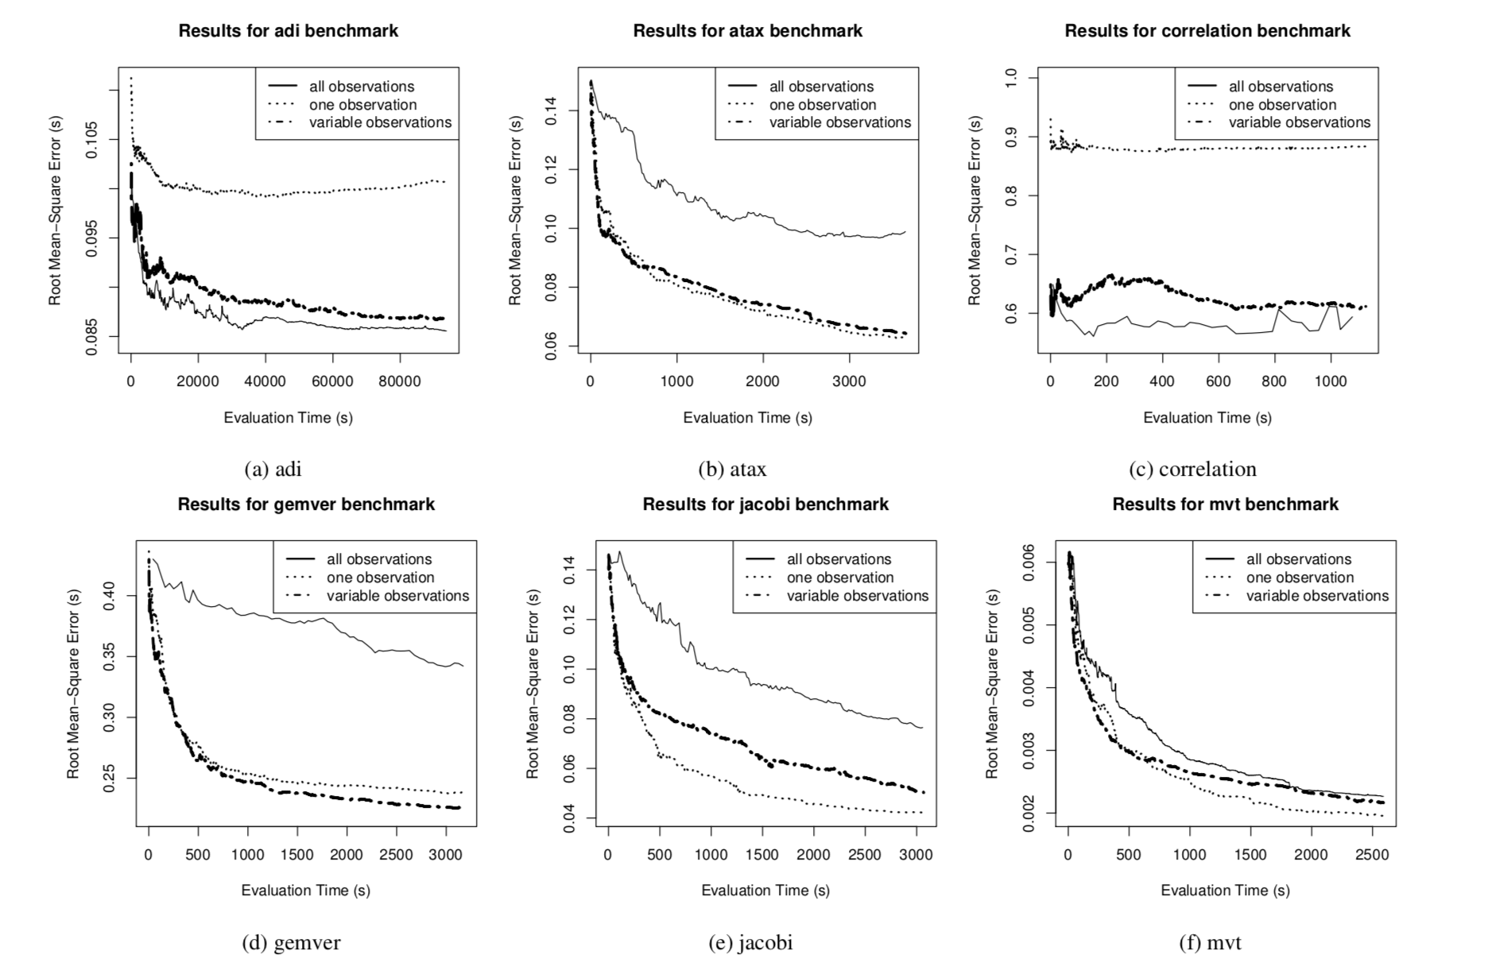

Slide 24
Critique
Maybe really an ML paper
"compiler" shows up only 10 times in the paper
6 times before introduction ends!

Slide 25
The Good
Presents a convincing alternative to random search and traditional techniques
Demonstrates that the state-of-the-art ML-based approaches have a big efficiency gap to overcome
Broadly applicable to compiler optimizations across domains (parallelism, performance, memory)

Slide 26
The Unclear
How good are the optimized outputs?
How well does the convergence generalize to other types of programs?
How does the learner scale if it must revisit old samples frequently?

Slide 27
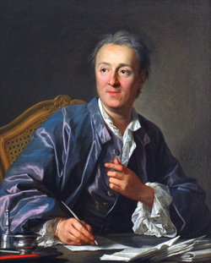
Discussion

